Slide 1
Car accident Severity
Predictor
IBM Data Science Course
Capstone Project
Yiyi Ji
20th September 2020

Slide 2
Introduction
Car accidents results in injury, disability, death and property damage.
Financial costs to society and individuals involved.
Will be the fifth leading cause of death by 2030.
Contributing factors to collisions: weather conditions, road conditions, light conditions, speed of operations, use of alcohol or drugs, etc.
By analyzing these factors, one could predict the severity of the accidents.
The accident severity predictions could be used to alert the drivers, the competent authorities
  drivers could avoid driving or taking alternative routes
  authorities can prevent accidents by taking necessary measures (for instance repairing roads, improving lightening, better design intersections, etc.) or prepare for the causalities by allocating resources in advance.

Slide 3
Data
From Seattle Department of Transportation, Traffic Management Division from 2004 to present.
Drop:
  Redunctant features
  Features with irrelevant information
  Fetures with high degree of missing values (66%-95%)
Useful features: location (given in geographical coordinates), weather condition, road condition and light condition.
unbalanced dataset (136485 cases of severity 1 (property damage only) and 58188 cases of severity 2 (injury))

Slide 4
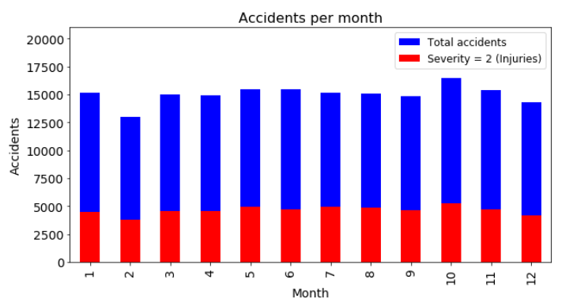
Data visualization

Slide 5
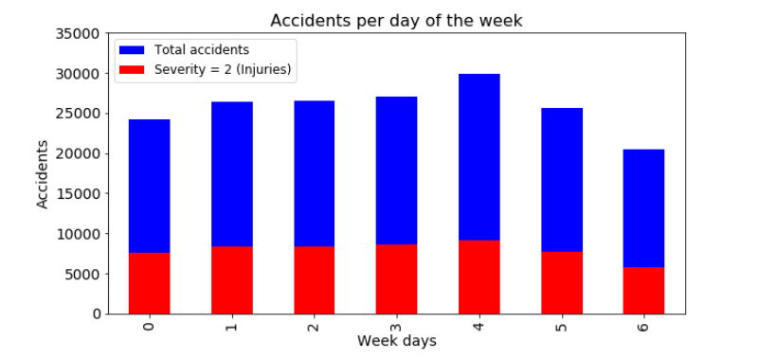
Data visualization

Slide 6
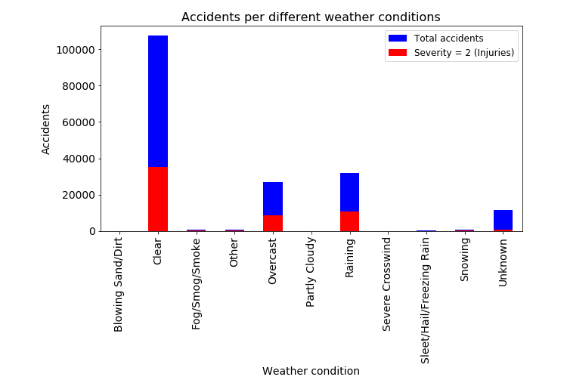
Data visualization

Slide 7
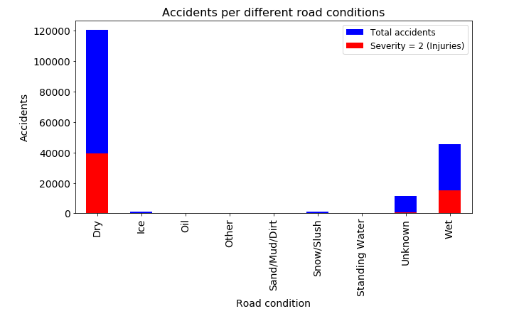
Data visualization

Slide 8
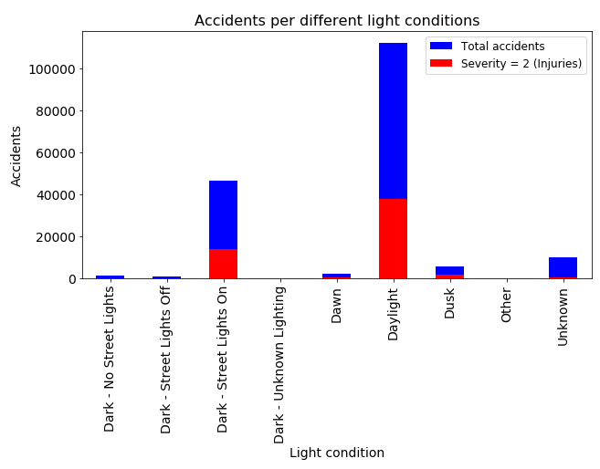
Data visualization

Slide 9
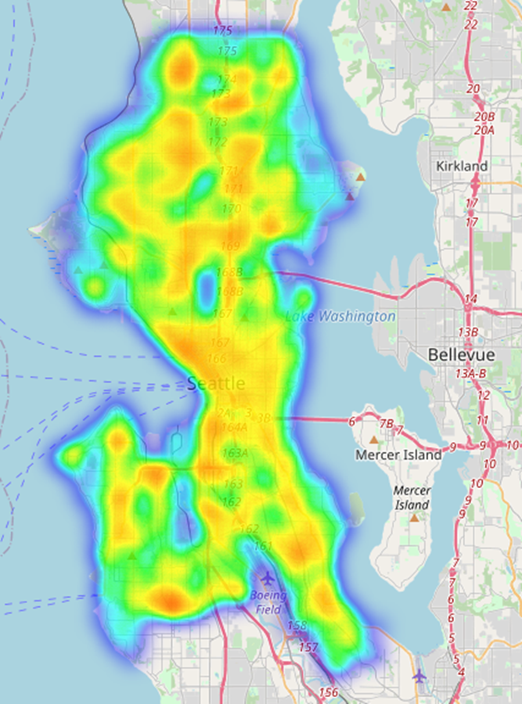
Data visualization
Location: all accidents

Slide 10
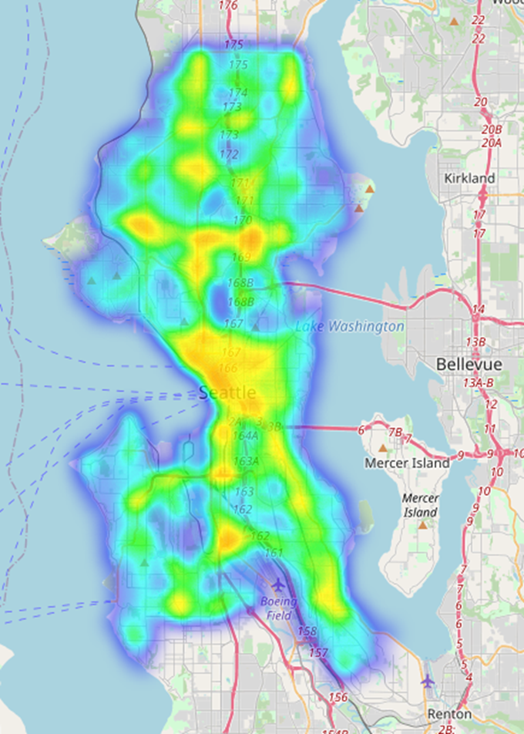
Data visualization
Location: severity 2

Slide 11
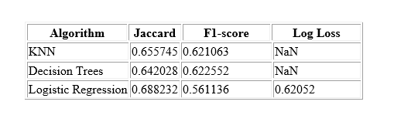
Machine learning model

Slide 12
Conclusion
A supervised machine learning model using logistic regression algorithm was built to predict accident severity based on weather, road and light conditions as well as geolocation.
Month and week day could be incorporated in the model to increase the performance of the models. It wasn’t included because its computationally heavy and takes very long time to process so many features.

